Slide 1

How to Setup, Use,
and Automate
vSphere Host Profiles and Auto Deploy
Russell Hamker
VMware Architect

Slide 2


Quote Slide: Leaf and Ocean Color Theme
Intro
Create a Tanzu Community Edition OVA Using HashiCorp Packer
About Me:
Russell Hamker
14+ years Running VMware
VCP5-2020
Employer – Guard Dog Solutions Inc
Title – VMware Enterprise Architect
vExpert – 7 years and running
VMUG Leader – Wichita KS
Twitter - @butch7903

Slide 3





Timeline for Host Configurations
Load Host Manually
Setup Hosts Manually
Load your host manually via ISO
Setup your host manually
Load 1 Host Manually
Setup 1 Host
via PowerCLI
Capture Host Profile
Standardize all Hosts via
Host Profiles
Deploy Hosts with
Auto Deploy
Load 1 host manually via Customized ISO
Copy the Host Configuration via Host Profiles
Setup host via PowerCLI for standardization
Apply Host Profiles to any existing hosts to standardize them
Setup Auto Deploy and deploy 10-1000’s of Hosts all with standard configurations via Host Profiles
Notes:
My Job today is to get you going from loading your hosts and configuring them manually to Automation via PowerCLI.
There are quite a few different levels we can go to with this automation. My goal today is to at least get you using Host Profiles via PowerCLI.

Slide 4
Host Profiles
The Host Profiles feature creates a profile that encapsulates the host configuration and helps to manage the host configuration, especially in environments where an administrator manages multiple hosts or clusters in vCenter Server.
Host Profiles provide an automated and centrally managed mechanism for host configuration and configuration compliance. Host Profiles can improve efficiency by reducing reliance upon repetitive, manual tasks. Host Profiles capture the configuration of a pre-configured and validated reference host, store the configuration as a managed object and use the catalog of parameters contained within to configure networking, storage, security, and other host-level parameters. Host Profiles can be applied to individual hosts, a cluster, or all the hosts and clusters associated to a host profile. Applying a Host Profile to a cluster affects all hosts in the cluster and result in a consistent configuration across the applied hosts.
Host Profiles can be used to validate the configuration of a host by checking compliance of a host or cluster against the Host Profile that is associated with that host or cluster.
Notes:
A host profile captures all aspects of a host. Everything from the ESXi configuration down to the hardware PCI configuration and saves all of this info in a file in the VCSA DB. This is used for host configuration automation and standardization.

Slide 5
Host Customizations – What are they?
To customize hosts with shared attributes, you can create a host profile in a reference host. To customize individual hosts, you can set up some fields in the host profile to prompt the user for input for each host.
When the host profile is set to prompt for user input (Host Customizations), you must specify a value in the dialog that appears when you reset the host customization. An error results if you do not specify a value.
Host Customizations can be set individually per host or may be imported using a specialized CSV file.
Examples of Host Customizations:
Host Name
Management IP
Management Subnet
vMotion IP
vMotion Subnet
Scratch Disk location
iSCSI IP configuration
Etc.
Notes:
To Customize a host, you will need to set Host Customizations.
Host Customizations are the individual settings for a host
like the Host Name, IP, etc.

Slide 6
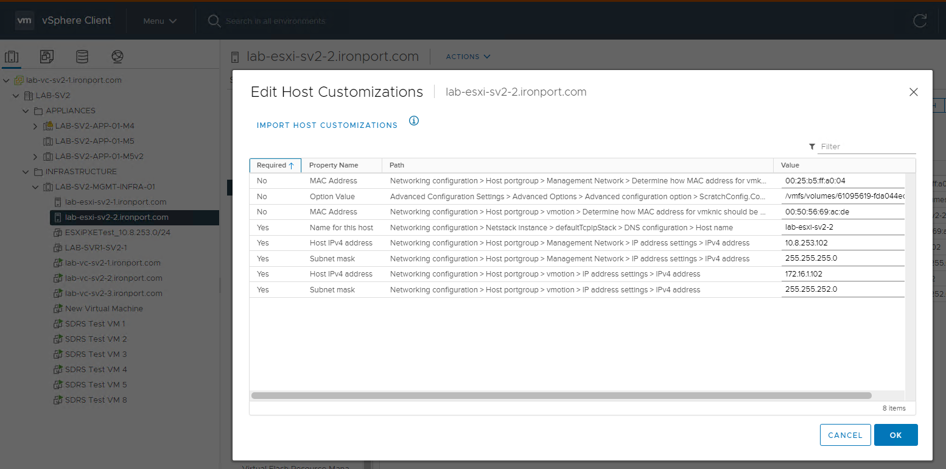
Example of Host Profile Customizations
Notes:
Here is an example of a Host Customization on a Host

Slide 7
Host Profile Automation
I have written a large amount of PowerCLI scripting to automate Host Profiles Configuration/Consumption
Here are a few things it does:
Generate a host profile (from a reference host)
Standardize its configuration per site (DNS, NTP, SATP Claim Rules, Auto Deploy Rules, Local Users/passwords, etc.)
Disable unneeded configuration (hardware specific configuration)
Set best practices for services and other basic configuration
Save the updated host profile back to your VCSA
Export the host profile for backup purposes (saves it as a flat file for later import if needed)
Set the host profile to be enabled on all hosts in the same cluster that share the same management default gateway
Create Auto Deploy Rules if needed (does not currently activate do to not being able to specify Host Image (VMware SR opened))
Complete a compliance check on all hosts that have the host profile attached.
Notes:
I have created a PowerCLI Script that will fully automate Host Profiles creation and standardization for you.
It also has the ability to automatically create Auto Deploy Rules based on that host profile for a cluster that shares the same Default Gateway.

Slide 8

Notes:
This video is going to show us how to Run my PowerCLI Script automation.

Slide 9
Host Profiles Usage Model
The Host Profiles workflow starts with the concept of a reference host. The configuration of the reference host, which is extracted as a host profile, serves as a configuration template for configuring other hosts. The reference host does not have to be related or associated with the host profile extracted from it.
Before you begin, ensure that you have an existing vSphere environment installation with at least one properly configured ESXi Host.
The sequence required to create a host profile from a reference host, apply the host profile to a host or cluster and check compliance against the host profile is as follows:
Set up and configure the reference host.
Create a host profile from the reference host.
Attach hosts or clusters to the host profile.
Import Host Customizations for all hosts.
Check the compliance to the host profile. If all hosts are compliant with the reference host, they are correctly configured.
Apply (remediate).
Notes:
The Host Profile Model starts with
Setup and configuring your reference host
Create a Host Profile from the reference host
Attach hosts or clusters to the host profile
Import or set the Host Customizations for all hosts.
Check Compliance of all hosts or cluster against the host profile
Apply the host profile to all hosts

Slide 10

Notes:
In this video I am going to show you where in the VCSA you can find the host profiles in the GUI.
I will then show you all the details of what a Host Profile looks like.

Slide 11
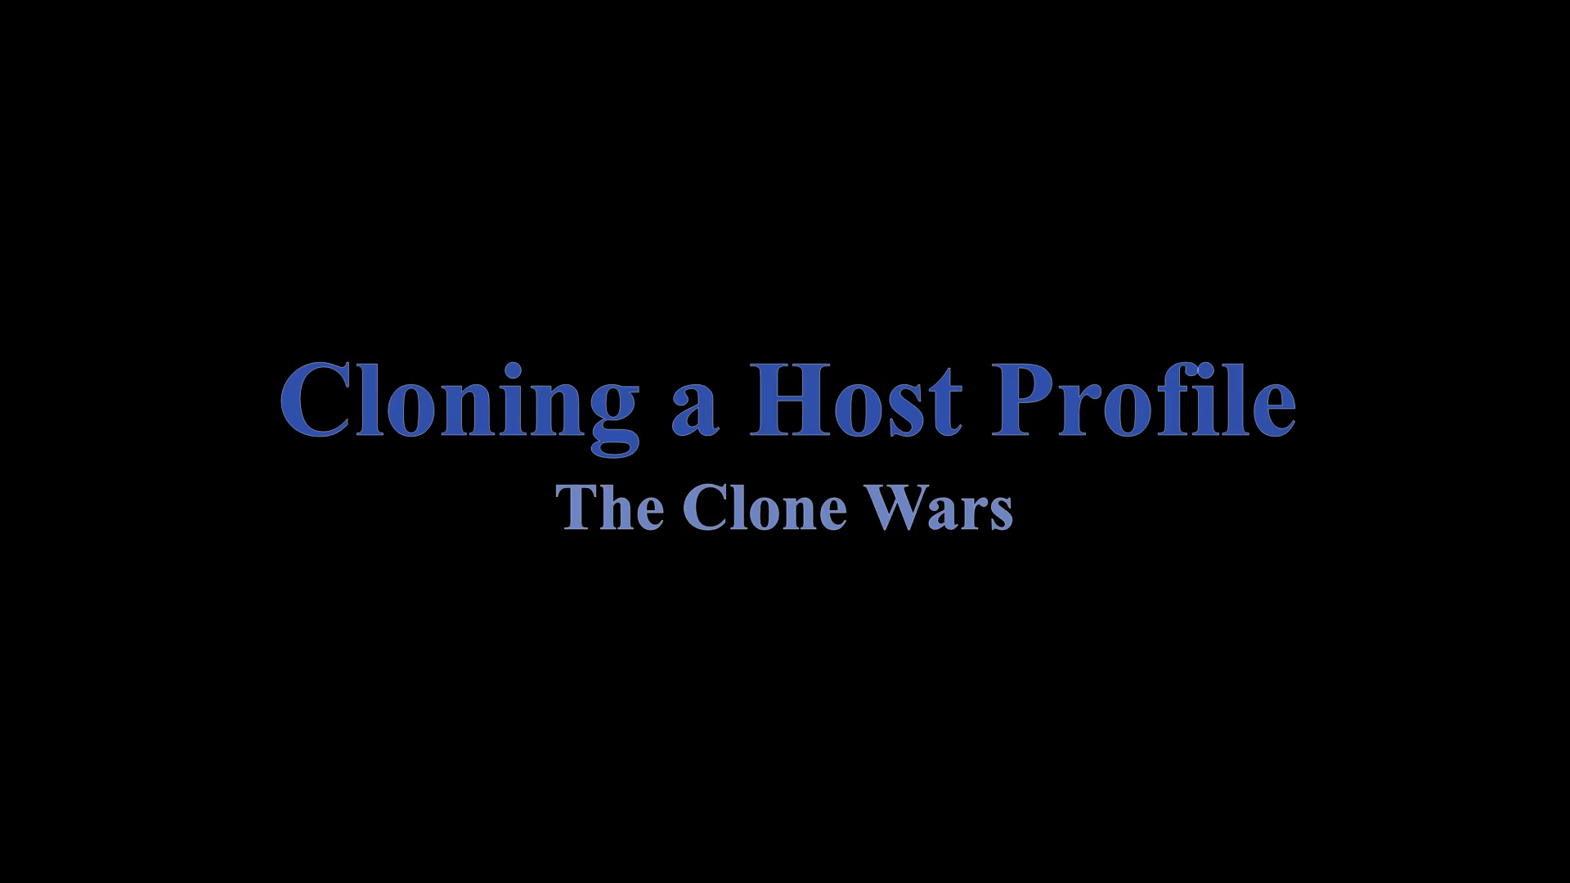
Notes:
In this video I am going to show how to clone a Host Profile and customize it for other hosts that don’t share the same default gateway

Slide 12
Why Setup vSphere Auto Deploy
vSphere Auto Deploy lets you provision hundreds of physical hosts with ESXi software.
Using Auto Deploy, experienced system administrators can manage large deployments efficiently. Hosts are network-booted from a central Auto Deploy server. Optionally, hosts are configured with a host profile of a reference host. The host profile can be set up to prompt the user for input. After boot up and configuration complete, the hosts are managed by vCenter Server just like other ESXi hosts.
Notes:
If you have 8 hosts or 1000 hosts, you want to setup Auto Deploy so you can auto provision and standardize all of your hosts moving forward.

Slide 13
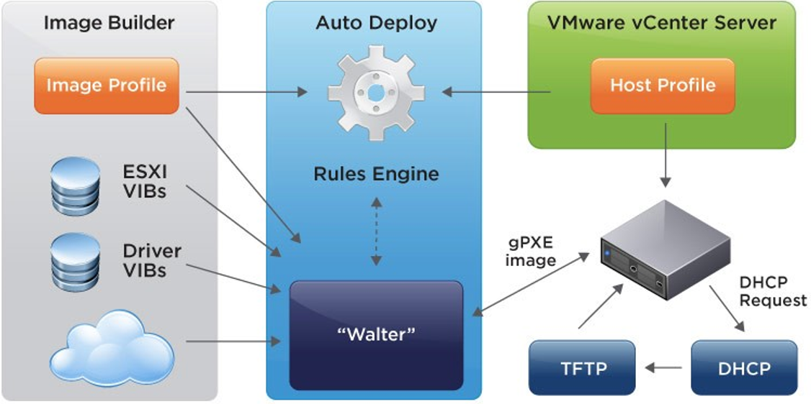
vSphere Auto Deploy Architecture
Notes:
Here is a diagram of the Auto Deploy Architecture
You can see that the VCSA works with a DHCP and TFTP server to PXE boot your host.
After initial PXE boot, Auto Deploy goes to work to look at your Auto deploy Rules
Auto Deploy works with Image builder to get the right ESXi and Driver VIBs and then completes booting your host

Slide 14
vSphere Auto Deploy Methodologies
PXE Boots Host, installs ESXi on local HD or USB/SD Cards
Can use Host Profiles to automate configuration
Can place host into specific cluster
Future upgrades are done via Lifecylce Manager/Update Manager
Can have VIB Drift post deployment
PXE Boots Host, installs a cached copy of ESXi on local HD or USB/SD Cards
Requires use of Host Profiles to automate most all configuration
Can place host into specific cluster
Updates are done by updating the ESXi bundle on the Image Builder service, and then reboot your hosts
Cannot have VIB Drift post deployment
Stateful Install
Stateless Caching
Notes:
There are 2 main different Methodologies to Auto Deploy
Stateful means you use Auto Deploy to only load ESXi 1x. You can use Host profiles if you wish to customize the host and place it in a specific cluster. After this is done you would need to use LifeCylce Manager to update your hosts. 1 thing to thing to be considerate of with this methodology is that you can have VIB drift with this.
Stateless Caching means you always try to use Auto deploy to boot your ESXi Hosts. If Auto Deploy or anything in the chain is down, the host can fail back to the cache to boot successfully. This does require you use Host Profiles and place your host in a specific cluster/location. Updates are much simpler with this as well. Simply update the Auto Deploy Rule with an updated Image and then reboot your host to complete it. This method cannot easily have VIB drift since it always gets its full image from the VCSA via PXE bootup.

Slide 15
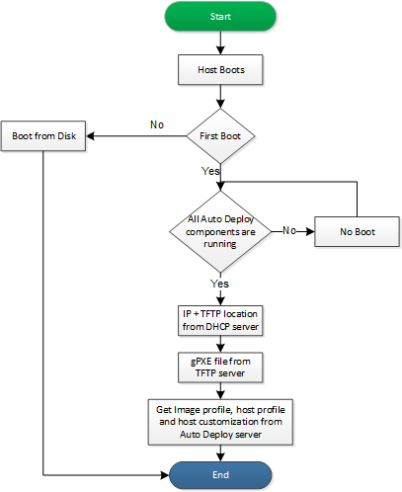
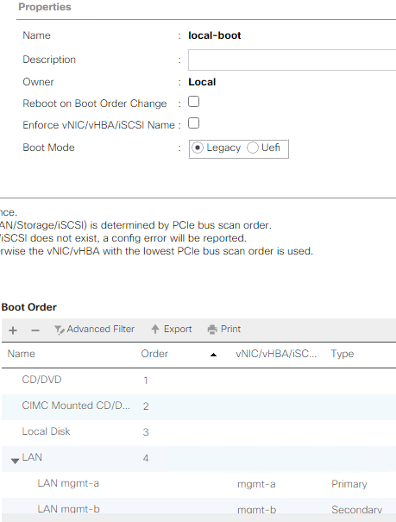
vSphere Auto Deploy Stateful - Boot Process
Stateful Install
Notes:
Here is the Boot Process for Stateful deployments. I also have an example of how to set a Cisco UCS Boot profile for this process.

Slide 16
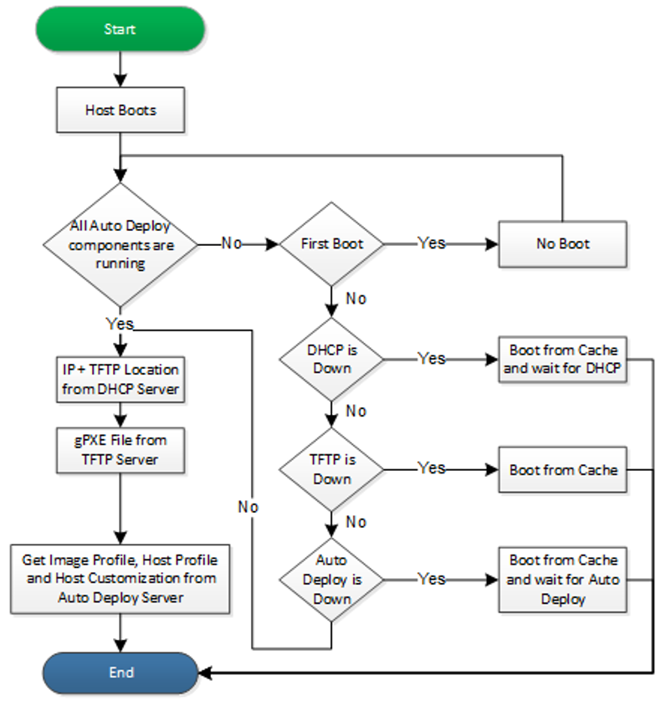
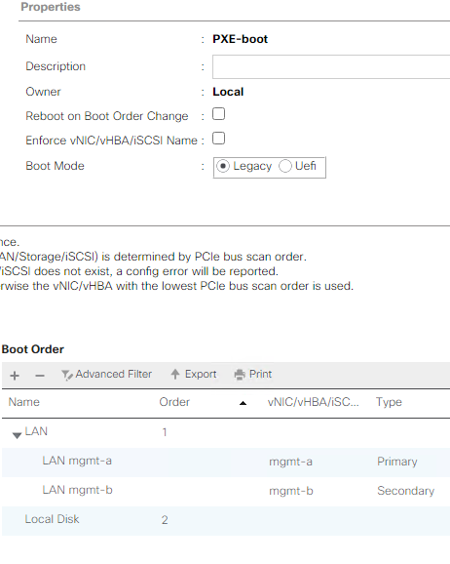
vSphere Auto Deploy Stateless Caching - Boot Process
Stateless Caching
Notes:
Here is the Boot Process for Stateless with Caching deployments.
Notice there is a lot of resiliency built-in for all scenario’s when something in the boot process chain isn’t working properly it fails back to the Cache. I have another example of how to set a Cisco UCS Boot profile for this process on the right.

Slide 17
Requirements to Setup vSphere Auto Deploy
VCSA
Enable VCSA Services
DHCP Server
DHCP Cluster Recommended
Setup DHCP Scope for Hosts with TFTP settings
TFTP Server (TFTPd)
Setup Folder with VCSA PXE boot files
Image Builder ESXi Bundle
Host Profiles (Configuration for your hosts)
Auto Deploy Rules
Cluster Location
Host Profile
ESXi Bundle to use
Firewall ACL
Notes:
Here is the laundry list of all things needed to setup Auto Deploy. These include
VCSA Services
A DHCP Server and scopes
A TFTP Server (you can run the TFTP server from your DHCP Servers if you wish)
An ESXi image uploaded to the Image Builder service
Host Profiles if you want to do host customizations. Note you don’t have to use Host customizations at all
And all the Auto deploy rules including
Cluster Location
Host Profile
And ESXi bundle to use
You may also need to open Firewall ACLs between all of your hosts, VCSA, DHCP, and TFTP servers. You can get more info on ACL requirements at https:\\ports.VMware.com

Slide 18
vSphere Auto Deploy Setup Steps
Enable VCSA Services Image Builder, Auto Deploy (rbd), and vSphere ESXi Dump Collector
Verify you have forward/reverse DNS entries created for all hosts, if not, create them
Setup DHCP Scope/Reservations for your hosts (Windows DHCP Cluster)
Setup TFTP Server (TFTPd)
Upload ESXi Image bundle to Image Builder Depot on VCSA
Create Host Profiles (automated with PowerCLI) – Must setup reference host first
Create/Update Auto Deploy Rules (semi automated with PowerCLI)
Set Boot Polices on Hosts to PXE first, then boot to local storage (Stateless Caching)
Boot/Reboot hosts to have then PXE to Auto Deploy
Configure Hosts with Host Customizations (Part of Host Profile process)
Verify Hosts are Compliant with Host Profile
Reboot final time to make sure all settings are completely setup.
Notes:
Here are the Auto Deploy Setup Steps:
Enable your VCSA Services
Setup forward/reverse DNS Entries for all hosts
Setup DHCP Scopes/Reservations
Setup your TFTP Server
Upload your ESXi Image to Image Builder
Create/Export your Host Profile from a Reference Host
Create/Update your Auto Deploy Rules
Set boot Policies on your physical Hosts
Reboot your hosts 1 at a time and convert them
Configure Host Customizations per Host
Verify Hosts are complaint
Reboot 1 final time after validation

Slide 19
VCSA – Setup Services Setup Steps
ImageBuilder
SSH to VCSA using root account
Toggle VCSA Shell if needed https://kb.vmware.com/s/article/2100508
Run below commands to set service to automatic and start the service:
vmon-cli -S AUTOMATIC -U imagebuilder
service-control --start vmware-imagebuilder
service-control --status vmware-imagebuilder
Auto Deploy
SSH to VCSA using root account
Toggle VCSA Shell if needed https://kb.vmware.com/s/article/2100508
Run below commands to set service to automatic and start the service:
vmon-cli -S AUTOMATIC -U rbd
service-control --start vmware-rbd-watchdog
service-control --status vmware-rbd-watchdog
VMware vSphere ESXi Dump Collector
SSH to VCSA using root account
Toggle VCSA Shell if needed https://kb.vmware.com/s/article/2100508
Run below commands to set service to automatic and start the service:
vmon-cli -S AUTOMATIC -U netdumper
service-control --start vmware-netdumper
service-control --status vmware-netdumper
Notes:
3 Services are need to be enabled on your VCSA for Auto Deploy to function properly
They include:
Image Builder
Auto Deploy
ESXi Dump Collector
Here I have all the commands how to set these via VCSA SSH. You can now also set these in the VCSA VAMI interface for 7u2 and above.

Slide 20
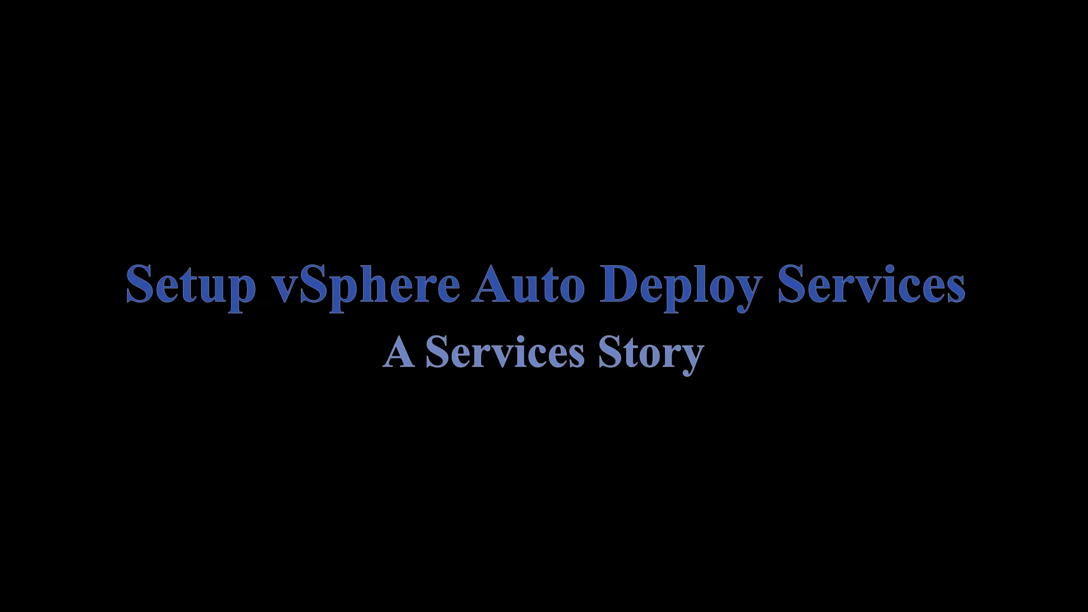
Notes:
In this video I will see how to Setup the VCSA Auto Deploy Services and Upload ESXi Bundle Image
Notes during video:
In VCSA 7u2, they also added the ability to set the services in the VAMI

Slide 21
Auto Deploy Limitations
Network and VCSA services (DHCP, TFTP, Auto Deploy, etc.) are a requirement. If they are down, you can not deploy new hosts
Hosts with the same management network can only PXE from 1 VCSA
Firewall requests may be needed to fully utilize
Auto Deploy Rules can only contain 1 location, image, and host profile
Notes:
There are a few limitations to Auto Deploy I want to go over
Network and VCSA services are required. If they go down, you cannot deploy new hosts.
Hosts with the same management network can only PXE from 1 VCSA (but there are ways to get around this with your DHCP server)
You may require Firewall rules to be opened between your hosts/VCSA/DHCP/ and TFTP servers
An Auto Deploy Rule can only have 1 location, image and host profile in its config

Slide 22
Auto Deploy Scenarios
There are a few different scenarios for when you will want to setup Auto Deploy. Each item has a few different steps involved. The overall outcome at the end though remains the same.
Scenarios:
An Existing Host
Adding Hosts to an Existing/New Cluster (Cloning Host Profiles)
A New Host
Notes:
There are a few different Auto Deploy Scenarios
Is an Existing host or cluster of hosts
Adding Hosts to an Existing or new Cluster
A new host
The overall outcome at the end remains the same

Slide 23
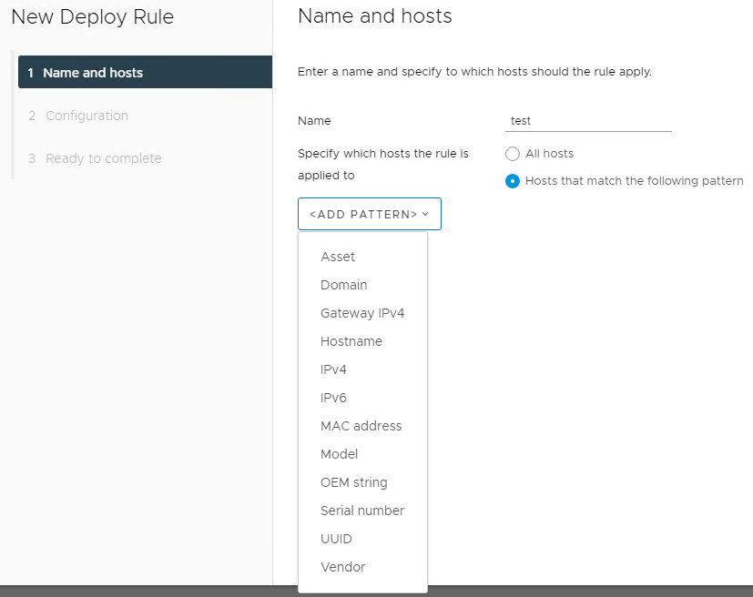
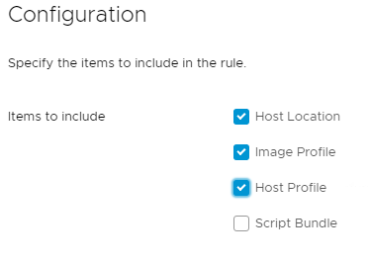
Auto Deploy Rules Breakdown
Name
The Unique name of the Auto Deploy rule
Pattern
The unique pattern specify a host in the rule
Host Location
Where the Host should land after booting
Image Profile
Image used to load ESXi/tools/etc.
Host Profile
Custom configuration applied to group of hosts
Script Bundle
Scripts that are run post host deployment to automate things not possible in a Host Profile
Notes:
Here is a breakdown of what makes up an Auto Deploy Rule
You can claim all hosts or claim them based on certain criteria.
There are 4 main configuration areas
Host Location
Image Profile
Host Profile
And Script Bundle – for advanced configurations that cannot be done via a Host Profile

Slide 24
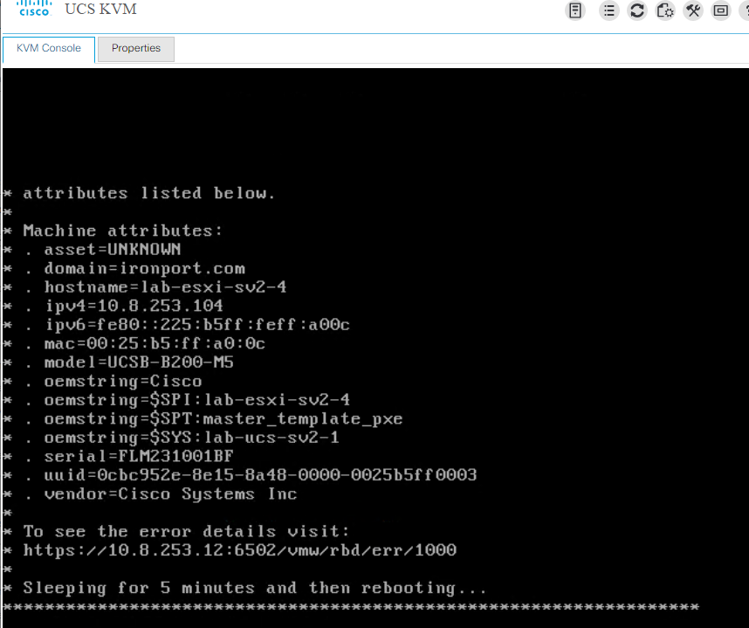
Attributes/Patterns you can use for Auto Deploy
Notes:
Here is an example of all the attributes from a UCS blade server after being booted via Auto Deploy without Auto Deploy rules associated with it. Notice all the things you can use for pattern recognition.

Slide 25
Different Methods of Auto Deploy-ment
New Hosts (Stateless Cache)
Boot order for stateless should be PXE/HD/SD Card
Must build reference host to build Host Profile, Can clone profiles if needed
Must create Image Profile
Should specify Host Location
Must have Auto Deploy Rule to apply to new host(s)
Will need to customize hosts using Host Customizations – Can be input manually or imported via specialized CSV.
Existing Hosts (migration to Auto Deploy – Stateless Cache)
Host must be placed into Maintenance Mode
Change Boot order for stateless to be PXE/HD/SD Card – Reboot may be required
Use existing host to create Host Profile
Must create Image Profile
Should specify Host Location
Must have Auto Deploy Rule to apply to new host(s)
Will need to customize hosts using Host Customizations – Usually already filled out, but must be saved/stored in the VCSA DB
Notes:
If you wish to go full Stateless with Caching, you will want to look at these 2 different methodologies
They include
New Hosts
Existing Hosts
There are different steps for each methodology, but at the end, both get you to the same end goal of Stateless with caching.

Slide 26

Notes:
Creating a Host profile from a reference host, applying host profile to host in same cluster with same default gateway,
Step 1. Import your ESXi Image into Image Builder
Step 2. Find the attributes you want to use to create your Auto Deploy Rule
Step 3. Configure your Auto Deploy rules with the pattern attributes you selected (In my example we use DNS host names), set host location, ESXi image, and host profile.
Step 4. You need to activate your Auto Deploy Rules

Slide 27
How to fix UCS Auto Deploy Cache issues
Place Host into Maintenance Mode
Disable monitoring for Host/UCS Blade
Disconnect Host from vSphere
Remove Host from vSphere inventory
Reboot Host
Open Hard Drive RAID management tool (Ctrl+R for M4/M5)
Manually delete RAID1 array (Select RAID, F2, Delete, OK for M4/M5)
Exit RAID management utility
Disassociate/reassociate blade to UCS Service Profile (~20 mins)
Resume setting up host using Auto Deploy
Notes:
If for some reason you run into the scenario that the host will not cache the ESXi image, you can follow these steps to fix the caching issue.

Slide 28
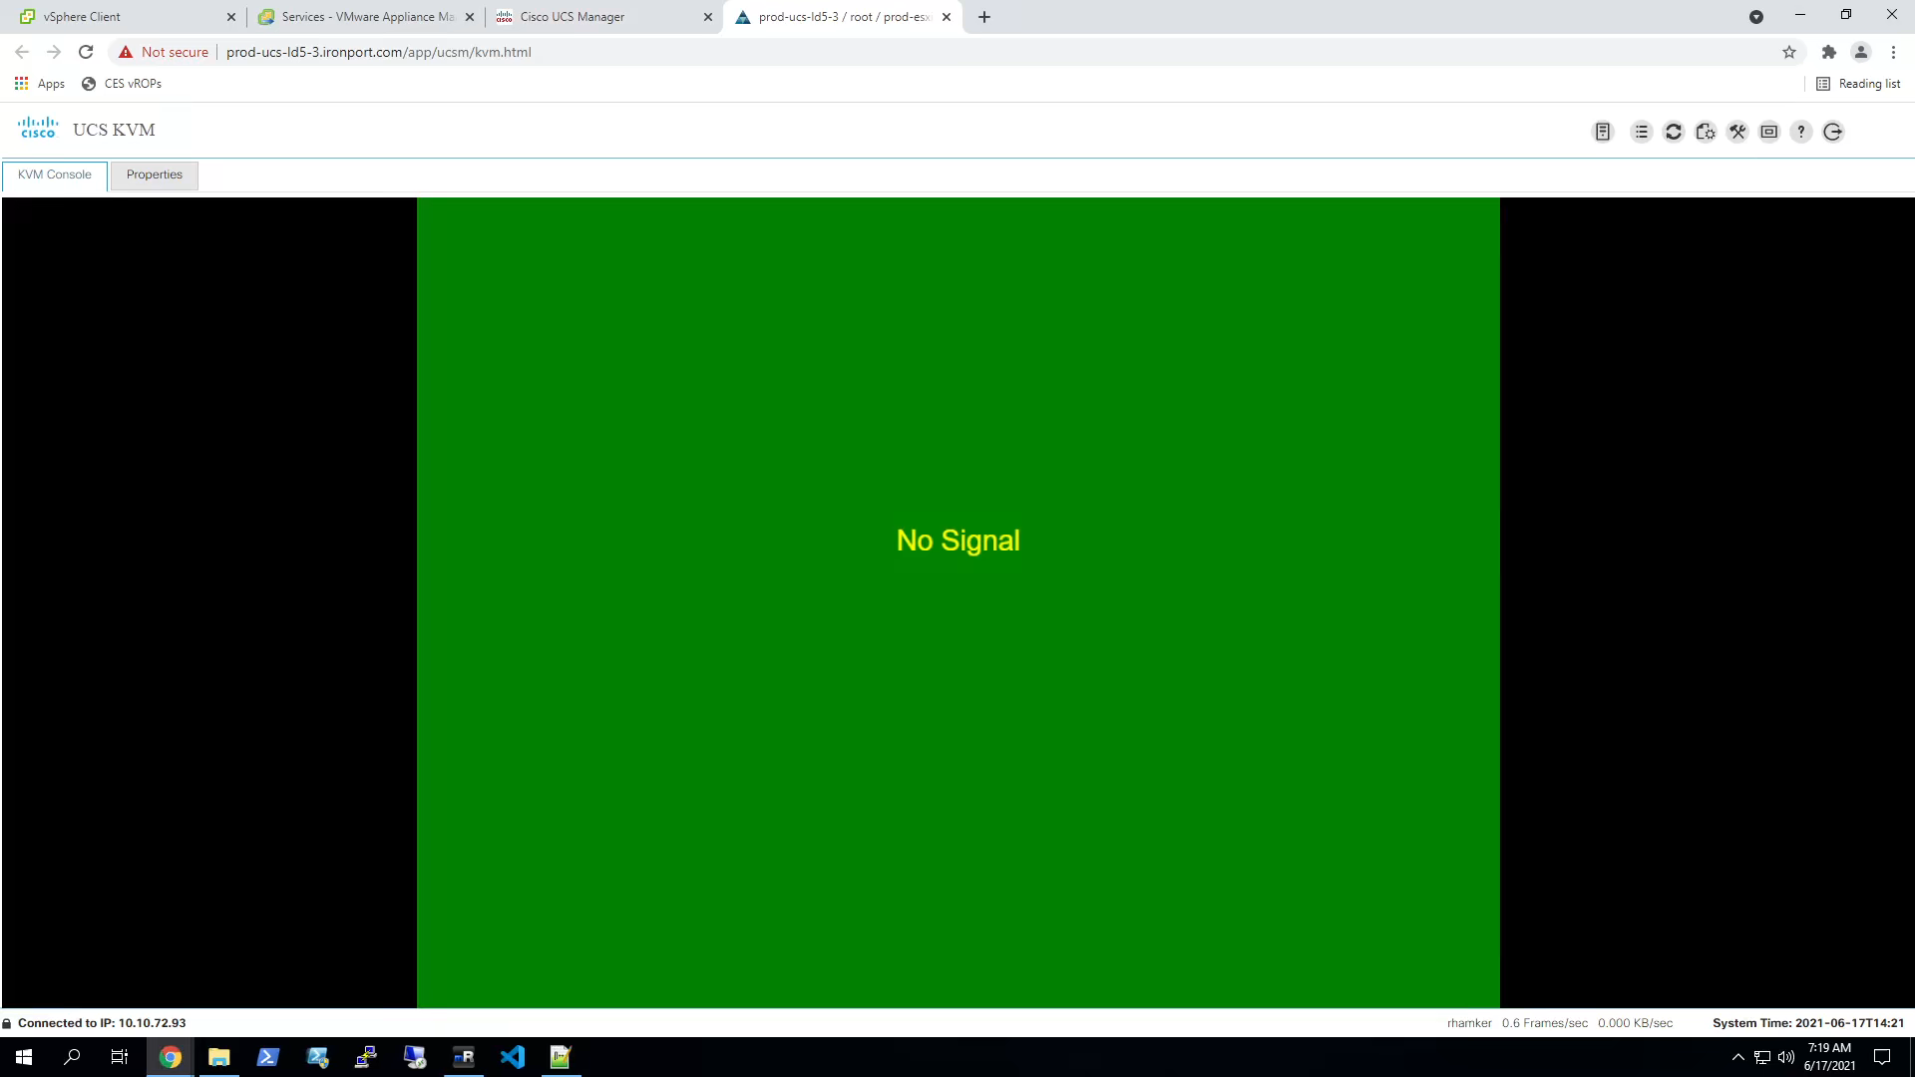
Notes:
Demo of host being rebooted and RAID deleted to resolve Auto Deploy Cache issue
Note: after blade profile is re-added video is done.

Slide 29
Common Links – Setup how to info
Installing ESXi using vSphere Auto Deploy
https://docs.vmware.com/en/VMware-vSphere/7.0/com.vmware.esxi.install.doc/GUID-CAB84194-3D8E-45F0-ABF9-0277710C8F98.html
Good Blog Articles:
http://www.electricmonk.org.uk/2019/01/11/taking-a-look-at-autodeploy-in-vsphere-6-5/
https://www.simongreaves.co.uk/understand-auto-deploy/
https://www.starwindsoftware.com/blog/vsphere-auto-deploy

Slide 30
Questions?
Q/A

Slide 31



Thank you!
Russell Hamker
VMware Architect
https://github.com/butch7903
Twitter: @butch7903 https://twitter.com/butch7903
LinkedIn: https://www.linkedin.com/in/russhamker/

Slide 32
HEVC Codec for Presentation
Video Demo playback requires HEVC Codecs
To install:
Windows:
Via PowerShell: start ms-windows-store://pdp/?ProductId=9n4wgh0z6vhq
Install free codec pack for HEVC
MAC:
https://download.divx.com/stable/divx/DivXInstaller.dmg
Install dmg file

